Slide 1
THERAPEUTIC COMMUNITIES: ORIGINS
Phaedon Kaloterakis

Slide 2
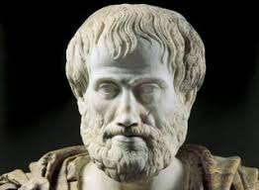
Aristotle’s principals of public speaking
tell them what you will tell them
tell them
tell them what you told them

Slide 3
Presentation outline
the bio-psycho-social approach
definition
the Origins of the Therapeutic Community
“it’s all Greek to me!”:how it works

Slide 4
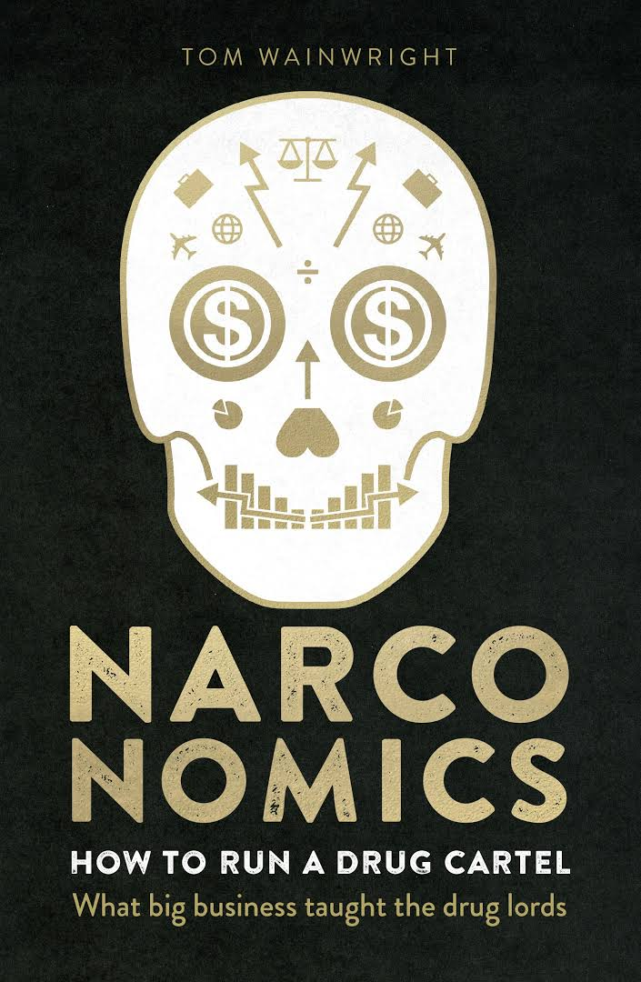
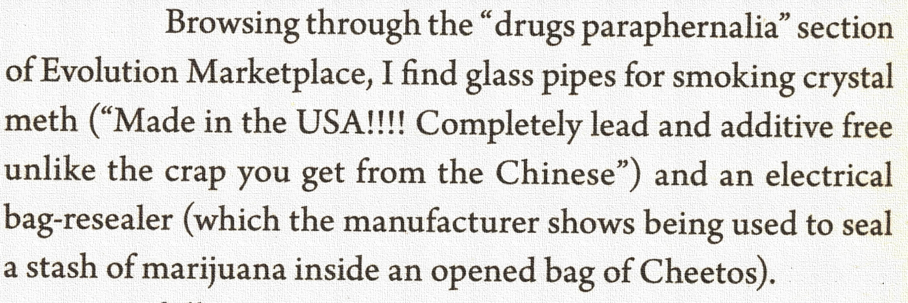

Slide 5
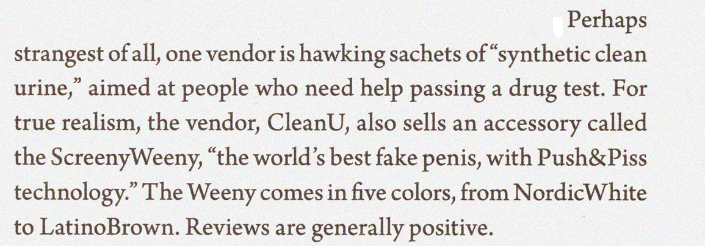

Slide 6
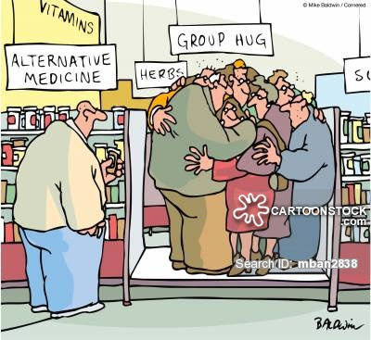

Slide 7
UNGASS 2016
The UN General Assembly held a Special Session (UNGASS) on drugs in April 2016
The adopted outcome document of UNGASS 2016 is entitled:
“Our joint commitment to effectively addressing and countering the world drug problem”
Notes:
Following a previous special meeting in 1998, a UN General Assembly Special Session (UNGASS) took place in April 2016, which adopted a consensus resolution entitled:
“Our joint commitment to effectively addressing and countering the world drug problem”
http://www.un.org/Docs/journal/asp/ws.asp?m=A/RES/S-30/1

Slide 8
Drug dependence is considered a multi-factorial health disorder that often follows the course of a relapsing and remitting chronic disease. Unfortunately in many societies drug dependence is still not recognized as a health problem and many people suffering from it are stigmatized and have no access to treatment and rehabilitation. Over recent years, the biopsychosocial model has recognized drug dependence as a multifaceted problem requiring the expertise of many disciplines. A health sciences multidisciplinary approach can be applied to research, prevention and treatment.
(Source: UNODC 2009)

Slide 9

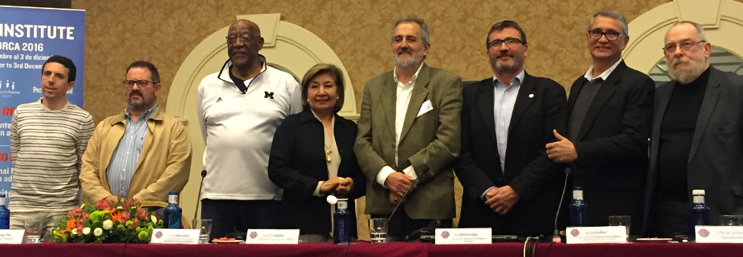
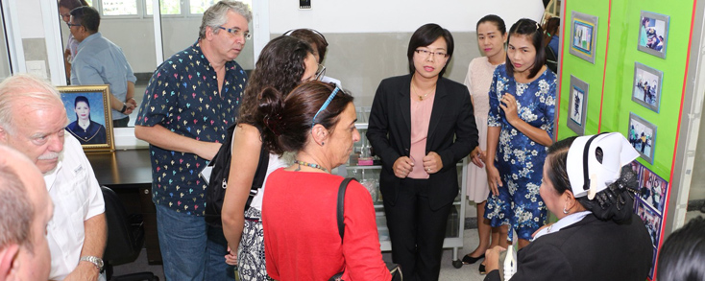
http://wftc.org/wps/
THE MISSION OF THE WORLD FEDERATION OF THERAPEUTIC COMMUNITIES
The World Federation of Therapeutic Communities (WFTC) is an international association with the goal of uniting and supporting the broad global Therapeutic Community (TC) movement worldwide (all five continents). WFTC provides sharing, understanding, guidance and cooperation to its members and the broader society.
In the occasion of the 5th WFTC Institute celebrated in 2016 in Spain, the WFTC adopted the Declaration of Mallorca, a document approved and committed by more than 150 experts in addiction and TCs from 26 countries. The document has been built based on actions, recommendations and agreements from primary care, treatment, recovery and social re-integration of drug-dependent population – including drug prevention – and it recognizes Therapeutic Community as one of the most effective approaches for the rehabilitation and recovery of persons with an addiction and their families.
The Declaration serves as guiding principles for the WFTC and its members and is expected to be implemented until 2026. Its content is grounded on the following standards:
– Commitment to People: seeking to provide the best service to persons with an addition and their families.
– Innovation: increasing effectiveness based on research, evidence and best practices.
– Participation: supporting participatory and transparent processes for decision-making in this field.
– Achievable: proposing concrete, clear and measurable actions with realistic, applicable and affordable conclusions.
– Willingness to Disseminate: seeing the value in sharing this knowledge with all stakeholders.

Slide 10
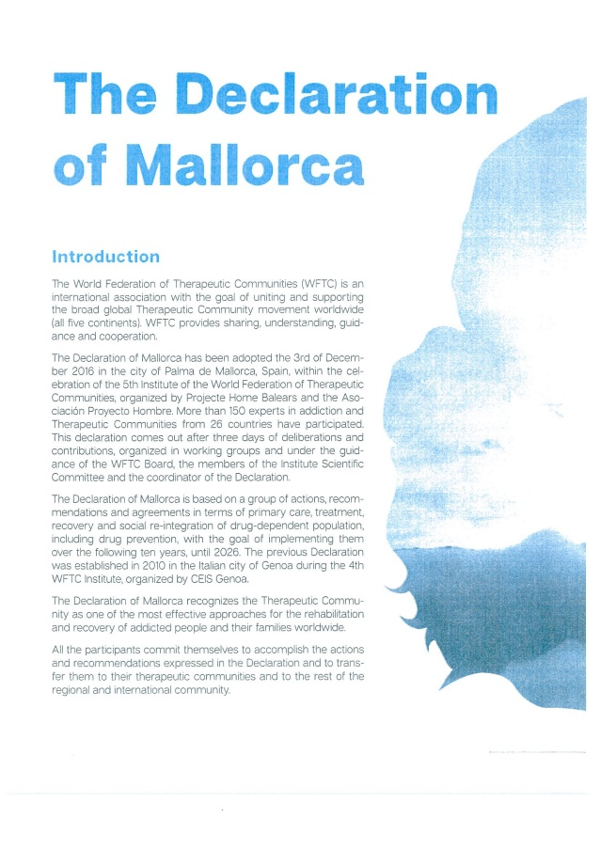
http://wftc.org/wps/

Slide 11

The Declaration of Mallorca, 2016
Therapeutic Communities require interdisciplinary professional teams,
including experts by experience, to deal with the complexity of addiction within
a bio-psycho-social framework.
Notes:
Trainer may ask one of the participants to read out the definitions. S/he then explains that policy and strategy could be confused with each other and then goes to the next slide that explains better the difference of the two.
The term of strategy is derived from the Greek word for generalship or leading an army.

Slide 12
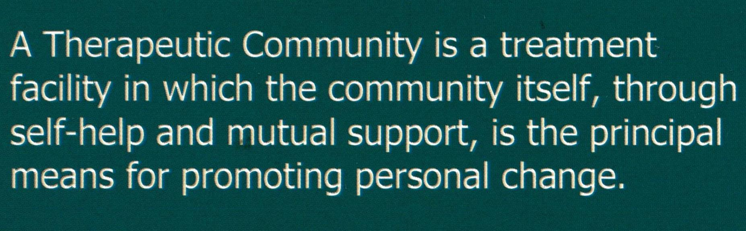

WHAT IS A THERAPEUTIC COMMUNITY?

Slide 13
“The doctor no longer owns “his” patients. They are given up to the community which is to treat them and which owns them and him. Patients are no longer his captive children, obedient in nursery-like activities, but have sincere adult roles to play and are free to reach for responsibilities and opinions concerning the community of which they are a part”.
Tom Main, 1946

Slide 14
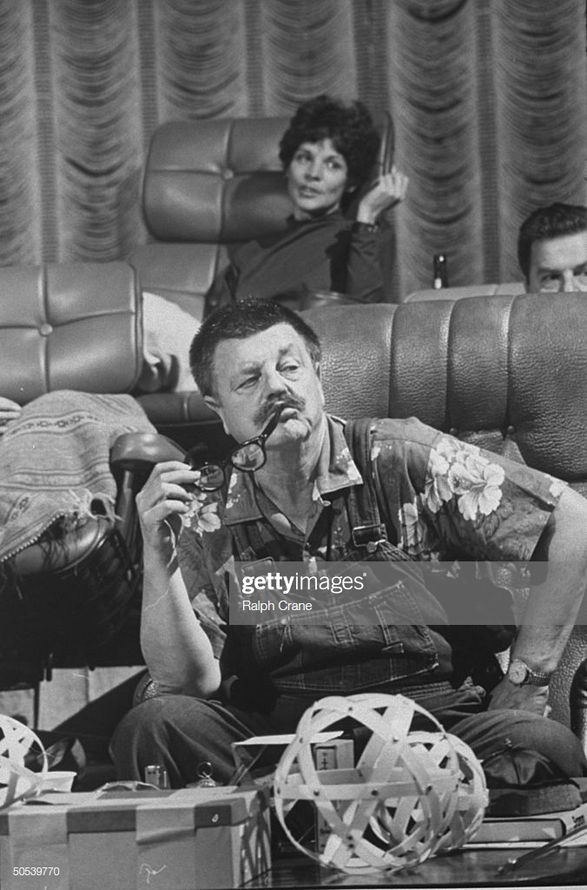
“Synanon is NOT a drug treatment. It’s a school where people learn to live right. Stopping shooting dope is just a side effect”.
Chuck Dederich (1961)

Slide 15
Qumran Community (Palestine)
Companions Du Devoir (France)

Slide 16
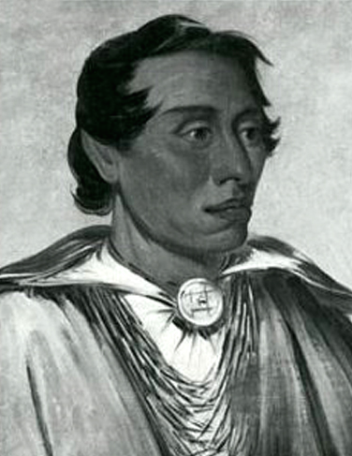
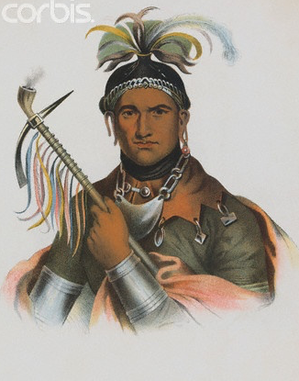
The Real TC Pioneers
Kenekuk the Kickapoo Prophet
an end to home violence
Handsome Lake
Seneca Chief (Iroquois Nation) – “our nation’s dignity”
Notes:
16

Slide 17
The Origins of the Therapeutic Community
The British Model The American Model
Educational/Social work
Mental Health
Self-help Groups
Northfield Military
Neurosis Centre
Belmont Industrial
Neurosis Unit
Henderson Hospital
Boy’s Republic
Little Commonwealth
Hawkspur Experiment
Summerhill School
Order of Woodcraft Chivalry
Oxford Group Movement
AA
Synanon
Daytop
Phoenix House

Slide 18
The Origins of the Therapeutic Community
The British Model
Mental Health
Northfield Military
Neurosis Centre
Belmont Industrial
Neurosis Unit
Henderson Hospital
BIOpsychosocial

Slide 19
The Origins of the Therapeutic Community
The American Model
Self-help Groups
Oxford Group Movement
AA
Synanon
Daytop
Phoenix House
bioPSYCHOsocial

Slide 20
The Origins of the Therapeutic Community
The British Model
Educational/Social work
Boy’s Republic
Little Commonwealth
Hawkspur Experiment
Summerhill School
Order of Woodcraft Chivalry
biopsychoSOCIAL

Slide 21
The Origins of the Therapeutic Community
The British Model The American Model
(democratic / old TC) (hierarchical / new TC)
Educational/Social work
Mental Health
Self-help Groups
Northfield Military
Neurosis Centre
Belmont Industrial
Neurosis Unit
Henderson Hospital
Boy’s Republic
Little Commonwealth
Hawkspur Experiment
Summerhill School
Order of Woodcraft Chivalry
Oxford Group Movement
AA
Synanon
Daytop
Phoenix House
First International Conference of Therapeutic Communities
Norrkoping, Sweden 1975

Slide 22


Slide 23


Slide 24
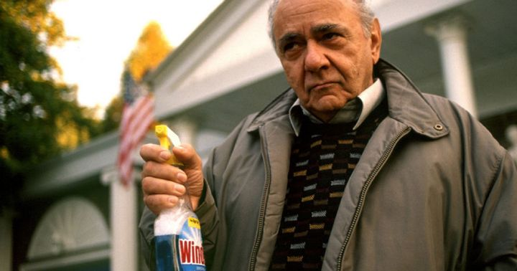

Slide 25
philosophy
philos + sophia
(friend) (wisdom)
=
psychiatry
psyche + iatriki
(soul) (medicine)
=
psychology
psyche + logos
(soul) (word/reason)
=
biology
bios + logos
(life) (word/reason)
=

Slide 26
ὅλον
σύνθεσις
συνέργεια

Slide 27
ὅλον
whole

Slide 28
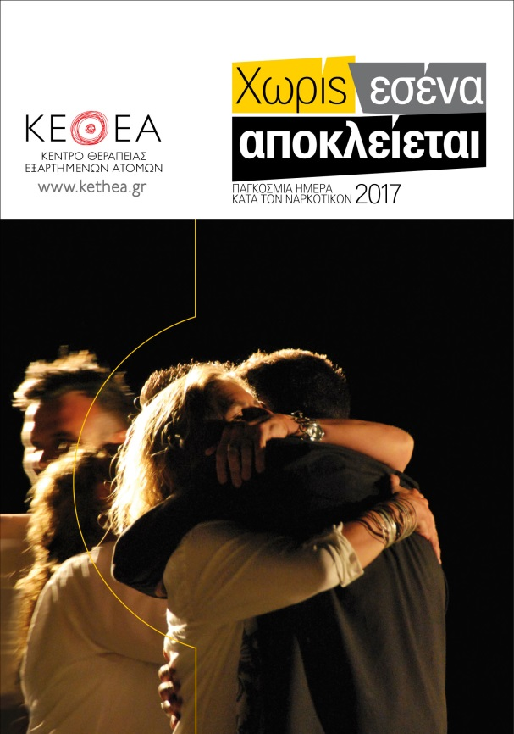
THERAPEUTIC community
Highlights of KETHEA’s wholistic approach
prevention department
research department
education department (schooling, vocational training, staff training, expert training in cooperation with UCSD, publications)
prison work
harm reduction
different populations (adolescents,
mothers with children, refugees, immigrants)
family therapy
national telephone helpline 1145
alcohol, gambling, internet
legal support
health care
activities ( sports, arts)

Slide 29
σύνθεσις
synthesis

Slide 30
CBT
MI
Systemic
Psychoanalytic
Gestalt
Rogerian
Psychodrama
Contingency Management
etc

Slide 31
συνέργεια
synergy

Slide 32
Treatment continuum
Prevention
Harm reduction / medically assisted treatment
Social re-integration

Slide 33
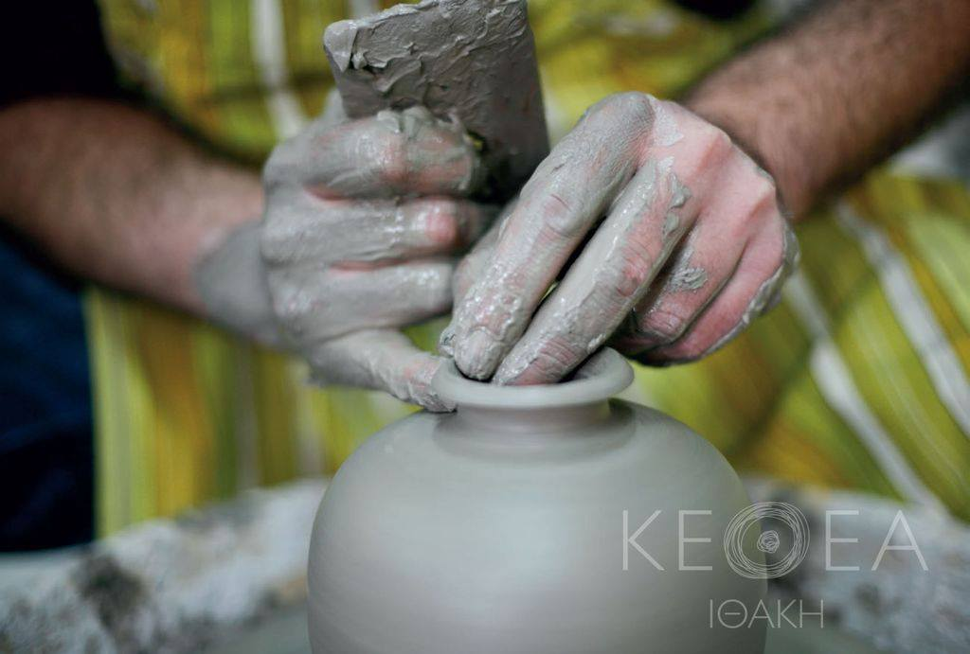
therapeutic COMMUNITY

Slide 34
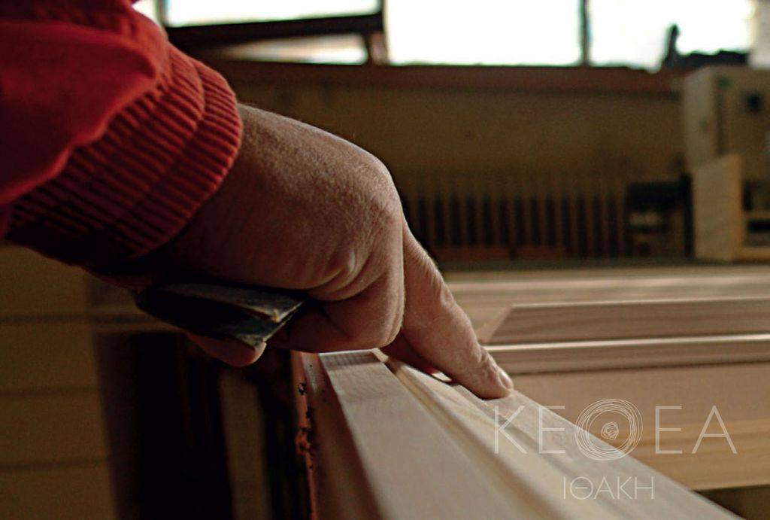
therapeutic COMMUNITY

Slide 35
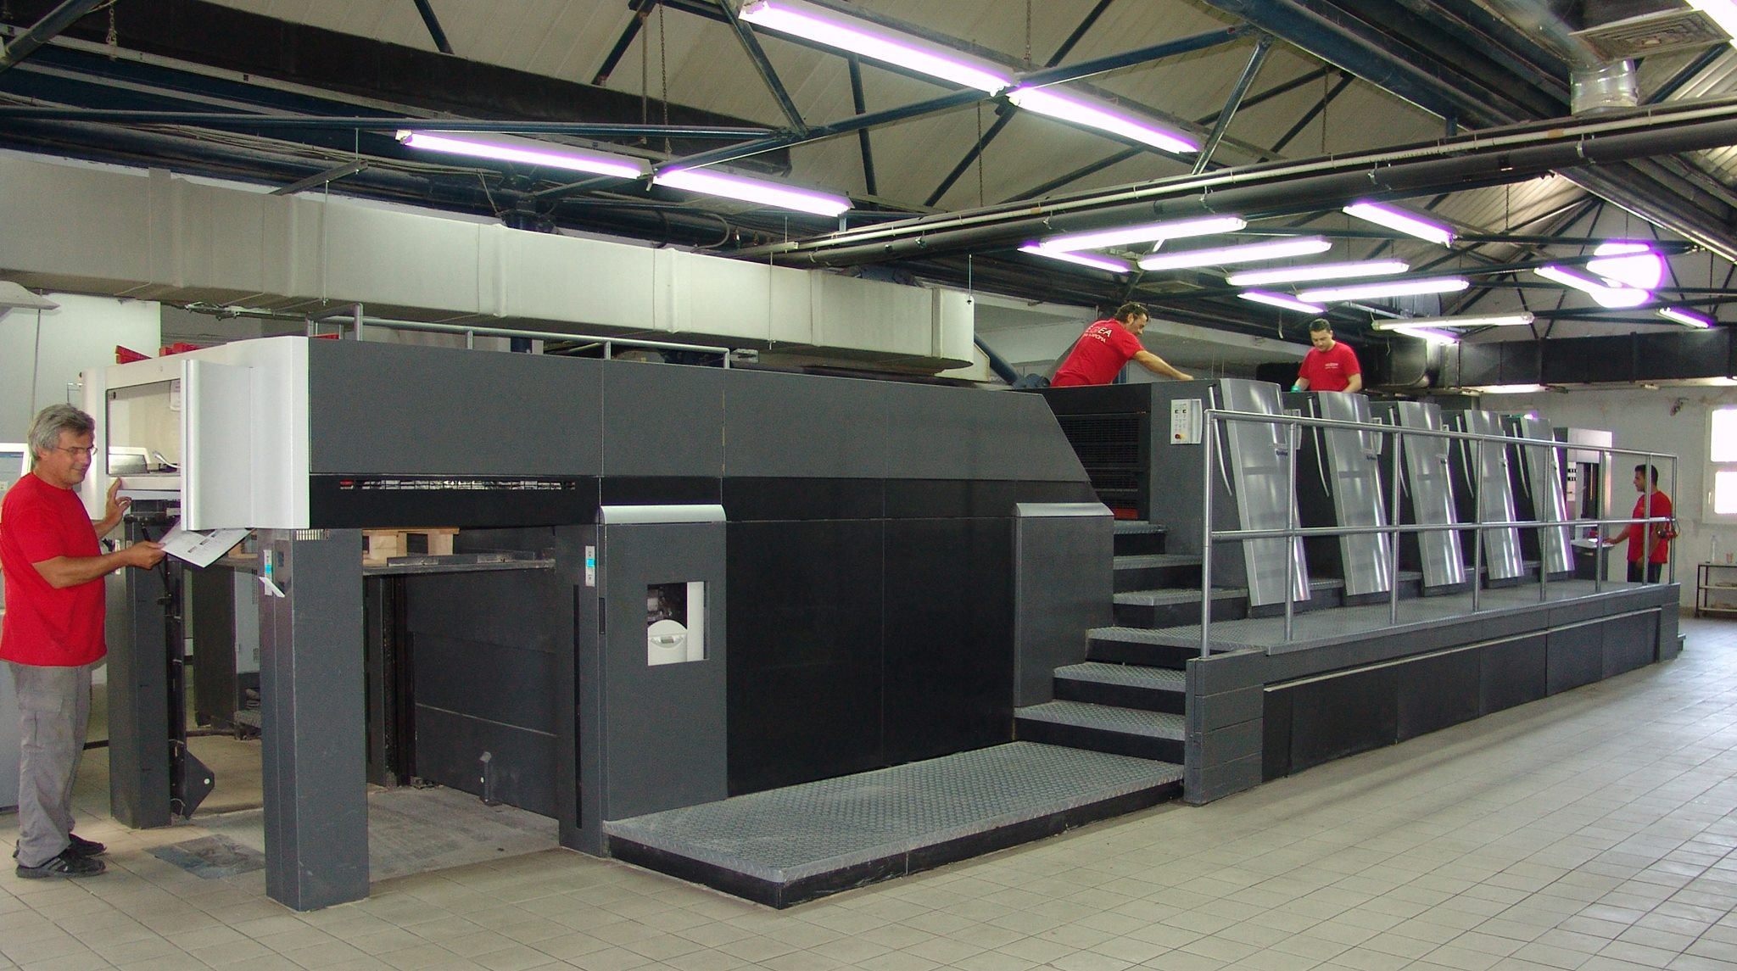
therapeutic COMMUNITY

Slide 36

therapeutic COMMUNITY

Slide 37
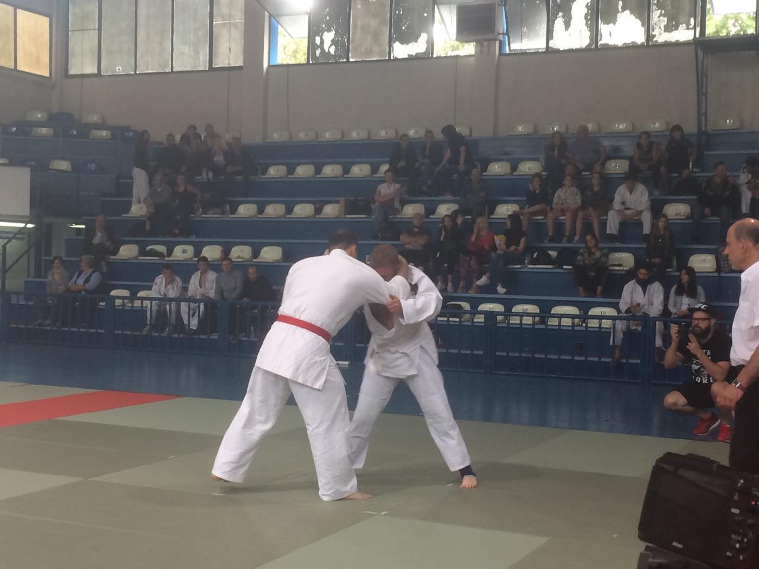
therapeutic COMMUNITY
JUDO IN A TC: ALMOST A FAIRY TALE

Slide 38
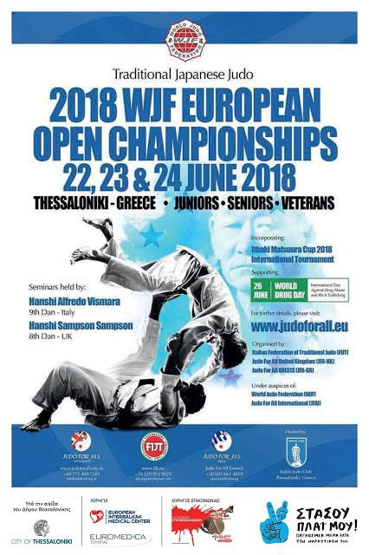
therapeutic COMMUNITY

Slide 39
THERAPEUTIC community

Slide 40
THERAPEUTIC community

Slide 41
THERAPEUTIC community

Slide 42
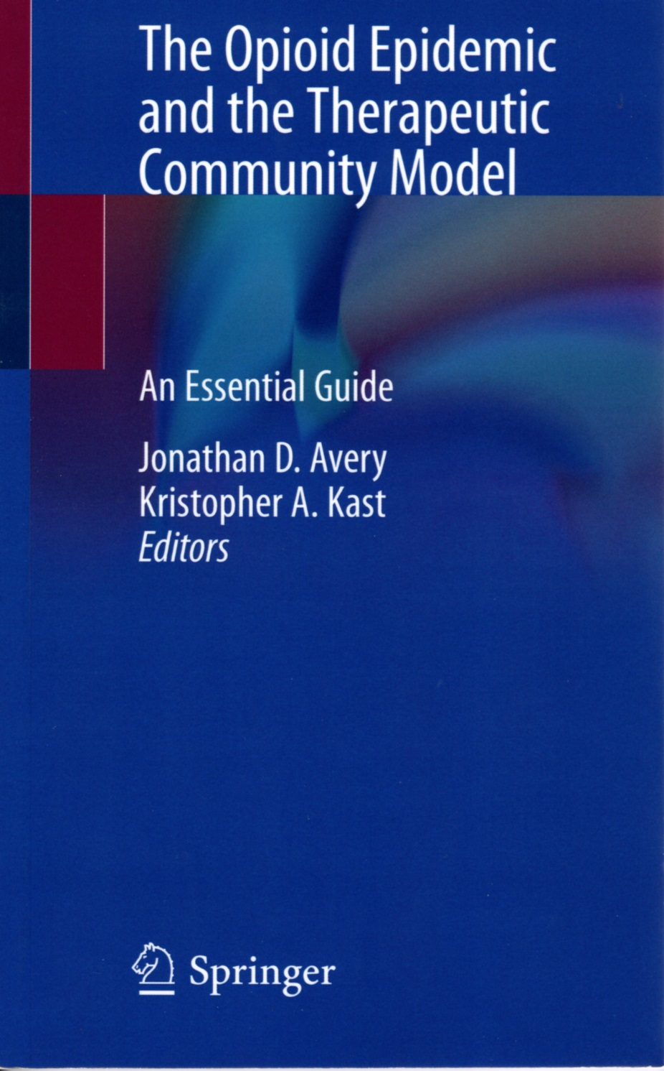
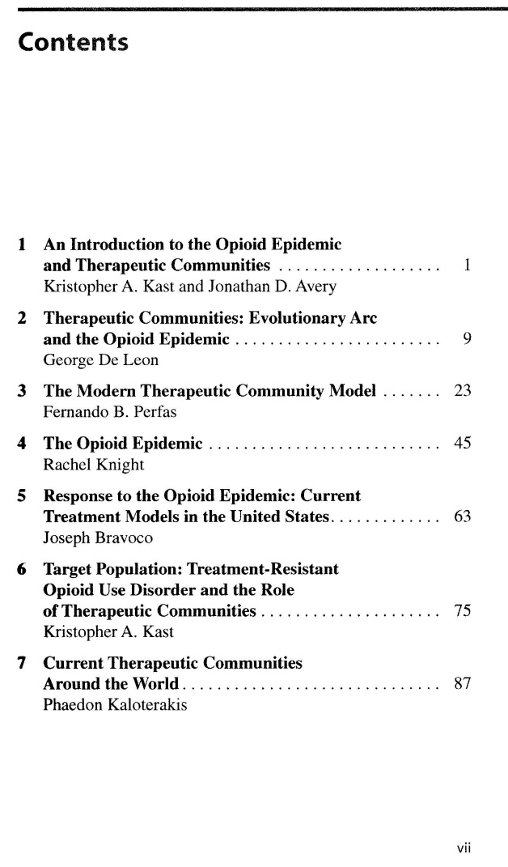
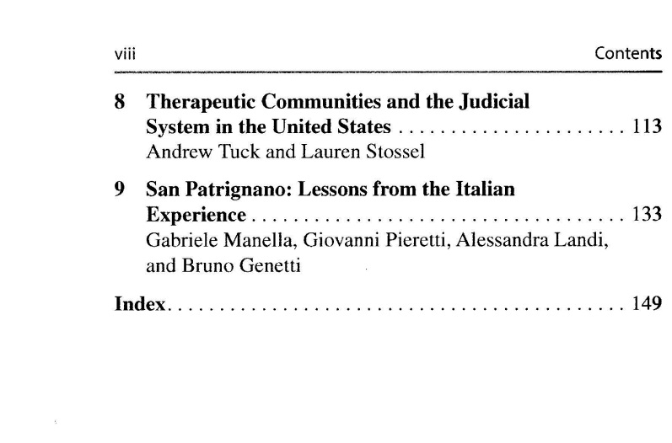

Slide 43
idiot
the word "idiot" comes from the Greek ἰδιώτης, idiōtēs 'a private person, individual', 'a private citizen'

Slide 44
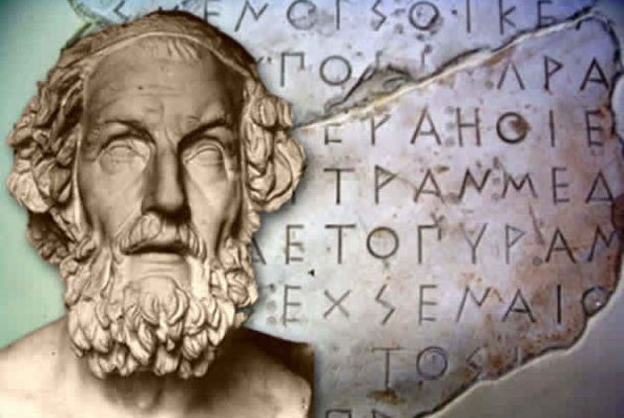
A final word
the word “therapy” has its roots in Homer
a therapist (θεράπων) was the servant of a warrior who used to take care of the warrior’s weapons and was helping him to wear his armor

Slide 45
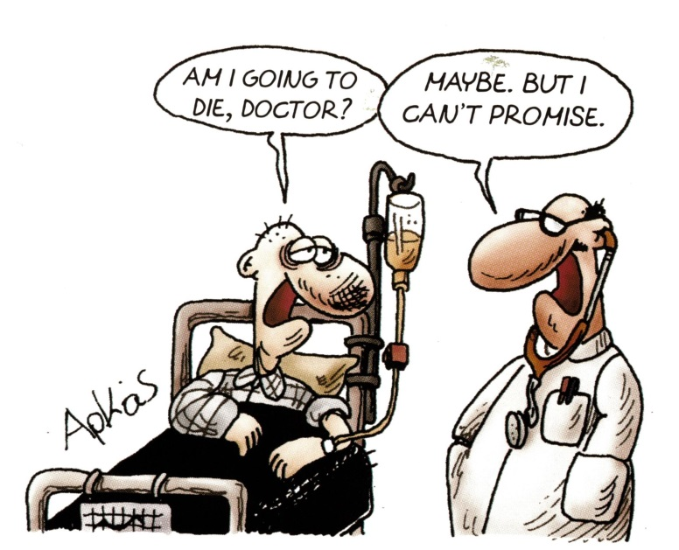
thank you! ευχαριστώ!
phaedon.kal@gmail.com

