Slide 1


The REAL Role of the Family
WHAT WORKS AND WHAT DOESN’T
Martin Infante
President, SELF

Slide 2
Background
In the Philippines (and most parts of Asia), FAMILIES admit their
loved ones into treatment.
In private facilities, families have the right to pull out the resident as they see fit.
Most of the residents return to their family homes after treatment.
Because of this, it became essential to develop an effective
Family Program that could support a resident’s recovery process.

Slide 3
Introduction
The hallmark of the SELF TC approach is its insistence that the ENTIRE FAMILY participate in the healing process.
Addressing both dependency and co-dependency is a bid to start a synergistic process that promotes EFFECTIVE RELATIONSHIPS between residents and their families.
This inter-dependence allows each to rely on EACH OTHER’S STRENGTH.
The establishment of recovery from codependency can influence positive changes in the FAMILY SYSTEM which can almost promise success in the recovery of the dependent.

Slide 4
Basic Facts
Relapse is part of Recovery -- The dependent needs a reasonably long program with various phases to address their “natural tendencies to relapse.”
Properly addressed, every relapse can be a good teacher towards the next effort
to attain recovery.
Clinical & Psychiatric Intervention is an essential “partner” of the Behavior Modification process of the TC approach.
Family Empowerment is crucial when coping with their loved ones during and after treatment.
Spiritual Development is the only guarantee for permanent success. That’s why SELF addresses the Whole Person in its Value Formation approach that emphasizes RIGHT LIVING.

Slide 5
There are THREE Players in the Recovery Process
Program
Resident
Family

Slide 6

#1 The RESIDENT
The KEY PLAYER
Can be MOTIVATED
Ultimately Makes the DECISION to change
Has a FEELING disorder and can relapse.
  “You can only bring a horse to the water...
  but the drinking is up to the horse”

Slide 7

Profile of a Dependent
NO LIMITS & BOUNDARIES
EXPERT LIAR
EXPERT MANIPULATOR
FALSE SENSE OF SECURITY (low self-esteem)
IMPULSIVE (low frustration tolerance)
RELATIONSHIP DEPENDENT (underdeveloped notion of friendship)
ALIENATED (reversed sleeping patterns)
Comes from a DYSFUNCTIONAL FAMILY

Slide 8
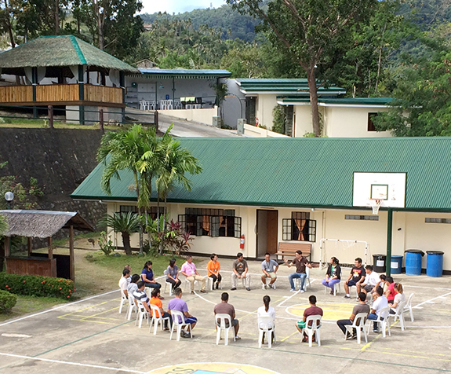
#2 The PROGRAM
Therapeutic Community Approach
Strict yet Caring Environment
Trained & Dedicated Staff
Inspiring Role Models
Conducive Facility
Well-defined Program Structure
Clear Rules and Regulations
Emotional Safety and Security
Spiritually Inspiring
Strong ‘Alma Mater’

Slide 9

#3 The FAMILY
THE FIRST LESSONS FAMILIES SHOULD LEARN …
They are NOT TO BLAME for the dependency or disorder.
They must NOT FEEL GUILTY about not rearing their child properly.
NOBODY PUT A GUN on the dependent’s head and made him/her take drugs or behave in such manner.
What families CAN DO is make their lives
a bit more pleasant by learning about
their own codependency issues and
IMPROVING THEIR OWN LIVES.

Slide 10
It is Crucial that families…
Attend the monthly FAM meetings and PARTICIPATE in the Family Therapy Group Sessions offered by the program.
Strive to become ONE-MINDED with the program and trust in the staff.
Learn & understand the healing process of the TC by engaging
in the prescribed INTERVENTION SESSIONS.
Use the RESIDENT-FAMILY RECONCILIATION GROUPS to help settle issues.
Discover their CODEPENDENT BEHAVIORS and begin their own process
of recovery from codependency.
Be steadfast in letting their loved ones FINISH the program.

Slide 11

What Codependents can do?
Recognize their own ACCOUNTABILITY in the family issues.
Resolve feelings of GUILT about rearing child improperly.
Become aware of SELF-DEFEATING attitudes and behavior.
Become open to THERAPEUTIC INTERVENTIONS.
Strive to develop SELF-EMPOWERMENT skills.
Learn the TOUGH LOVE method of the TC.
SHIFT away from the EGO and find MEANING in life.
LET the dependent grow.

Slide 12
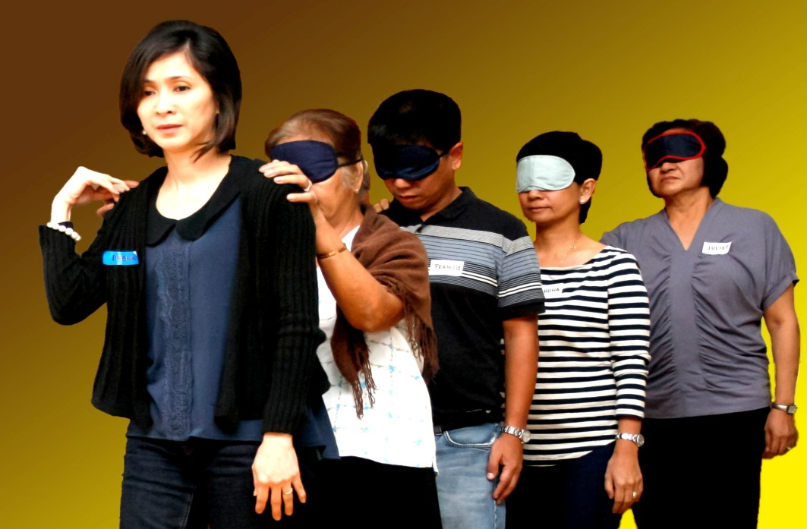
The SELF FAMILY EMPOWERMENT PROGRAM
CONCEPT, STRUCTURE AND MECHANICS

Slide 13
THREE COMPONENTS of the SELF Family Empowerment Program
1. Monthly FAM Meetings
2. Resident-Family Interventions
3. Aftercare Continuing Care Meetings

Slide 14
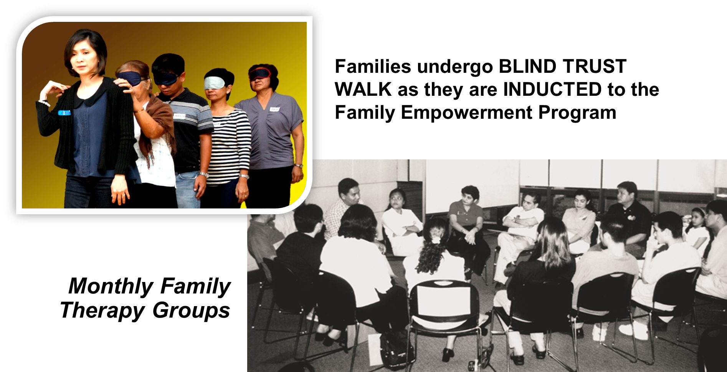
1. The Monthly FAM

Slide 15
What is the FAM?
The Family Association Meeting (FAM) is a REQUIRED ACTIVITY FOR ALL FAMILIES and is held every first Saturday of the month.
The FAM is a SUPPORT SERVICE vital to all family members as it addresses the phenomenon of codependency.
The meetings provide the following services:
      Consultation on Resident Monthly Progress Reports
      Seminars on the TC, Personal Growth and Recovery
      Family Group Therapy Sessions

Slide 16
Objectives
To develop a better understanding of the true
“Nature of the Beast” (dependency).
To gain an appreciation of “Why we do what we do”
in the TC program.
To understand the REAL “Role of the families” during
and after the treatment and rehabilitation process.

Slide 17
What the FAM offers
A SUPPORT SYSTEM that seeks to educate families on the realities and
dysfunction of codependency.
A program that EMPOWERS FAMILIES to change their own lives and get into their own “recovery” from codependency.
An OPPORTUNITY to view the dependency issue in the family as a blessing and a means to renew bonds.
A chance to identify and establish HEALTHY FAMILY OPERATING SYSTEMS that foster family unity and growth.
An invitation to SPIRITUAL AWAKENING and renewal.

Slide 18
2. The Resident - Family Interventions
A series of services provided to initiate the healing process
between residents and their families.
1
2
RESIDENT & FAMILY ENCOUNTER
3
FAMILY DAY
FAMILY COUNSELING
4
RESIDENT & FAMILY DIALOGUES

Slide 19
1) Family Counseling
Counseling sessions for family members ONLY:
To guide them in getting in touch with their INNER FEELINGS.
To enlighten them on the CLINICAL & TC APPROACH of the program.
To explain the BEHAVIORAL DYNAMICS of a resident in treatment.
To prepare them for their first RECONCILIATION GROUP with the resident.

Slide 20
2) Resident & Family Encounter
A critical RECONCILIATION GROUP between the residents and their families, as this is their first encounter with the resident after admission.
  To clarify CLAIMS that are being made by the resident.
  To IDENTIFY PAST DESTRUCTIVE EVENTS that will validate the need for treatment.
  To confront THINKING ERRORS that hold back the resident's progress.
  To allow residents to seek INITIAL RESOLUTIONS on some issues.
NOTE: More such interventions may be requested in the course of the program as newfound conflicts arise.

Slide 21
3) The Family Dialogue
At this stage (around 3 months), residents are ready to:
Family members are likewise expected to be open to resolve conflicts. The Family Dialogue promotes the following:
  Allow residents to initiate further resolution on some issues.
  Discuss family dynamics and suggest improvements.
  Promote openness in the discussion of family issues.
Own-up to their behavior
Clean their own mess
Support
their change

Slide 22
4) The Family Day
After passing the CASE DEFENSE INTERVIEW, the resident is entitled to a FAMILY DAY where family members visit the facility to enjoy the following activities:
  To celebrate their first sober family festivity.
  To introduce the resident’s family to the TC community.
  To exchange growing up moments.

Slide 23
Typical Schedule of a FAMILY DAY
Step 1: When families arrive, resident opens the main gate of the facility and welcomes them.
Step 2: Family is briefed on the objectives of the Family Day.
Step 3: A “positive” dialogue ensues between the resident and his/her family.
Step 4: The resident is allowed to have lunch with his/her family (food brought by the family).
Step 5: The resident takes family on a Tour of the TC Program and explains work tasks.
Step 6: The Family and TC Community share growing up moments with the resident.
Step 7: The family and resident is debriefed. Family Day ends.

Slide 24
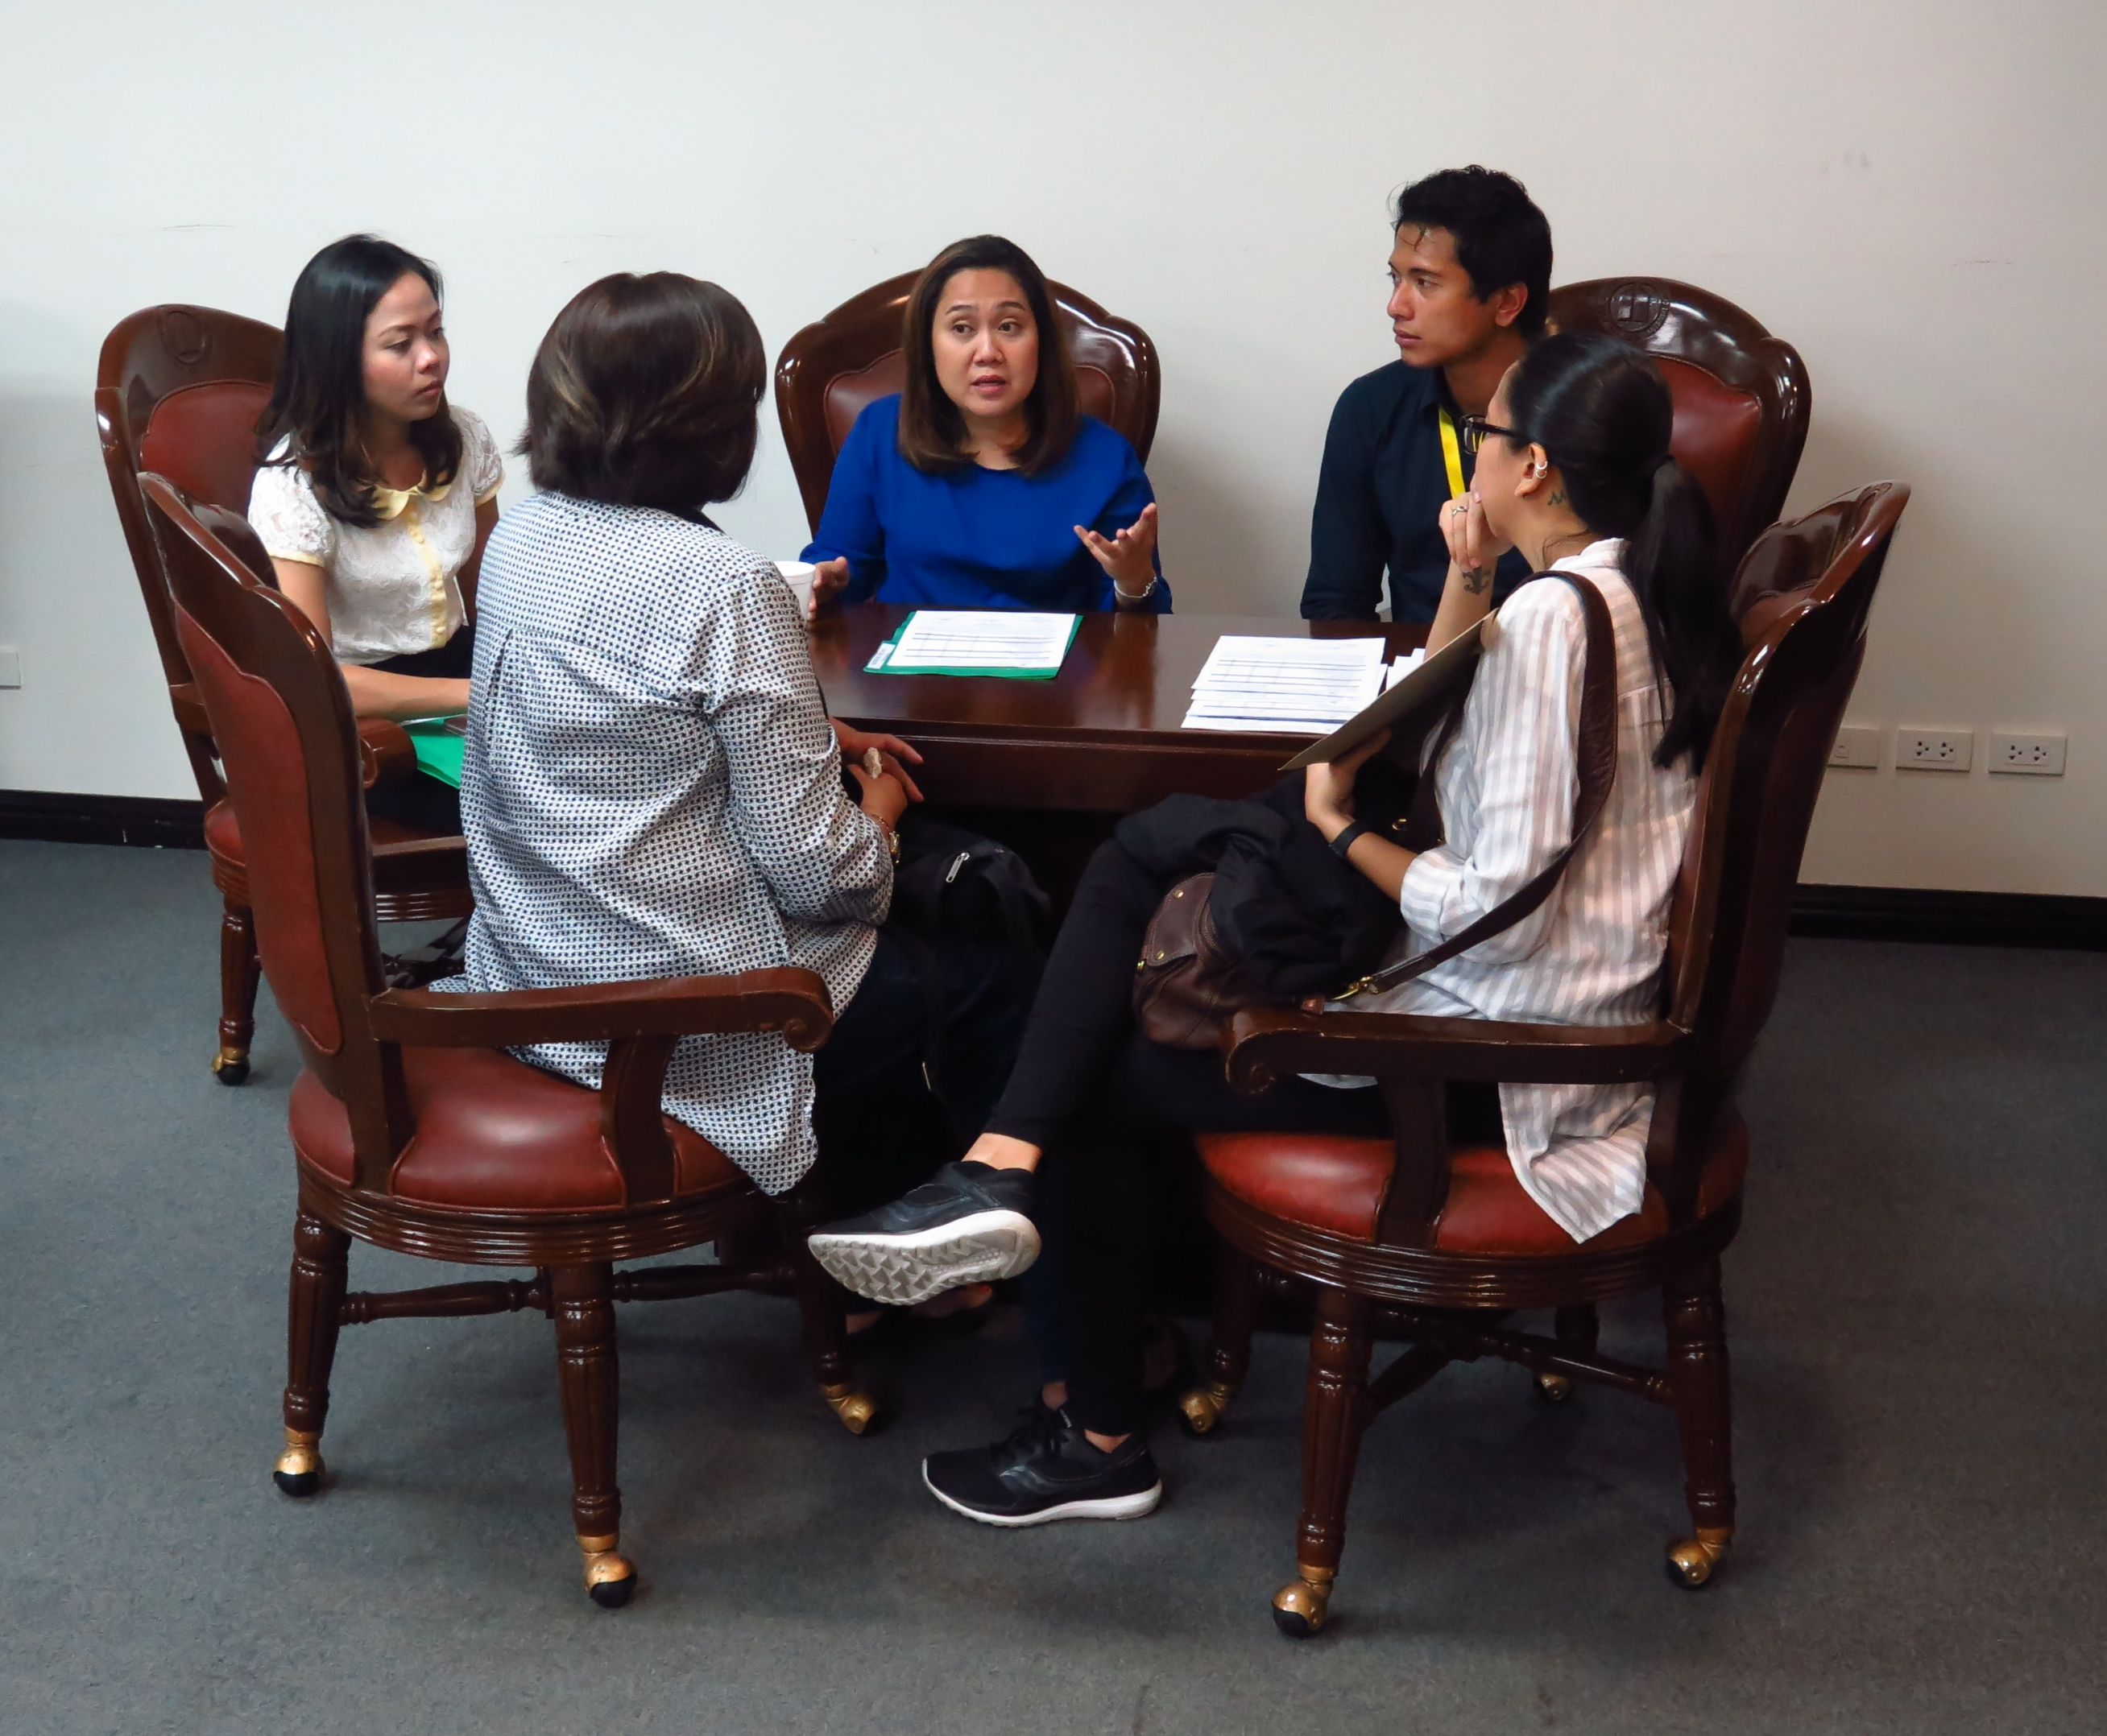
The Hallmark of this Model
CRUCIAL decisions on the resident are made
ONLY when the family is on board.

Slide 25

SELF AFTERCARE
CONTINUING CARE MEETING
3. The ACCM
Establishing Teamwork Between Aftercare Residents and Their Families

Slide 26
What is the ACCM?
Aftercare Continuum of Care Meeting (ACCM)
A 6-month activity for both Aftercare Residents and their FAMILIES held once a month.
A “one-stop-shop” service for all Aftercare Residents and their Families.
An EXCLUSIVE program for AC residents of the same batch or year.

Slide 27
OBJECTIVES
To monitor resident adherence to AC planned structures and activities.
To provide Family Team Building education to the AC resident and their families.
To engage in an INTERACTIVE feedback where all stakeholders are able to express and resolve issues pertaining to the AC resident’s process.

Slide 28
In Closing
  We tell families that…
  While necessarily long, REHAB WILL END too.
  Your loved one will INEVITABLY return to you.
  Expect CHALLENGES. It’s part of recovery.
  Like any dependency, YOU TOO CAN RELAPSE.
  Its okay! Just get back on the “HORSE OF RECOVERY.”
  It works IF YOU WORK IT!

Slide 29
An aphorism for families
Easy to forgive, hard to forget, always afraid!
-- Tony Gelormino

